Slide 1


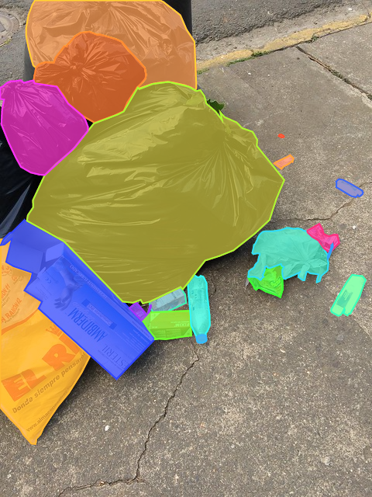
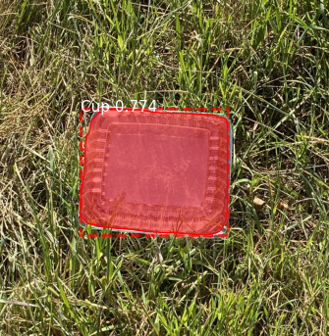
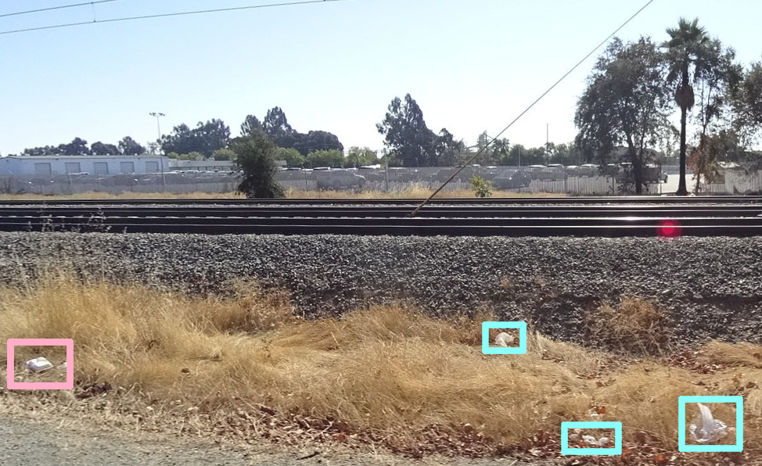

Searching for Uncollected Litter with Computer Vision
Julian Hernandez
Faculty Mentor: Dr. Fitzgerald
California State University, Sacramento
Abstract
This study combines photo metadata and computer vision to quantify where uncollected litter is present. Images from the Trash Annotations in Context (TACO) dataset were used to teach an algorithm to detect 10 categories of garbage. Although it worked well with smartphone photos, it struggled when trying to process images from vehicle mounted cameras. However, increasing the variety of perspectives and backgrounds in the dataset will help it improve in unfamiliar situations. These data are plotted onto a map which, as accuracy improves, could be used for measuring waste management strategies and quantifying trends.
Trash Annotations in Context (TACO)
Results
Precision $=\frac{True Positive}{True Positive + False Positive}$
Recall $=\frac{True Positive}{True Positive + False Negative}$
Mapillary: Precision = 1% and recall = 3%
Clean Up Images: Precision = 81% and recall = 74%
Challenges
Mask-RCNN can’t translate to a new perspective
Low quality images cause noise
New backgrounds causing lots of false positives
Introduction
Waste production is doubling every decade
Only 10% of plastic is recycled
270 species are harmed or killed by waste pollution
Globally costs over $200 billion a year
Waste produces 5% of global GHG emissions
80% of marine waste originates on land
Masked Regional Convolutional Neural Network (Mask R-CNN)
Future Work
Increase the size of the TACO dataset
Adding images, community annotations, new categories
Continue training with images from new perspectives
New perspectives, backgrounds, and devices
Fix car mislabeling issue using new training images
Research Question
Can computer vision help identify new areas that need to be cleanup and measure how much waste is removed?
Clean Up
Mapillary
Methods
Algorithm: Masked Regional Convolutional Neural Network
Training dataset: Trash Annotations in Context
Detection datasets: Mapillary and hand collected images
Conclusion
For car mounted camera detection many more images are needed
Detection works on smart phone images and can be used in clean up strategies today
References available upon request from julianhernandez@csus.edu

